Slide 1
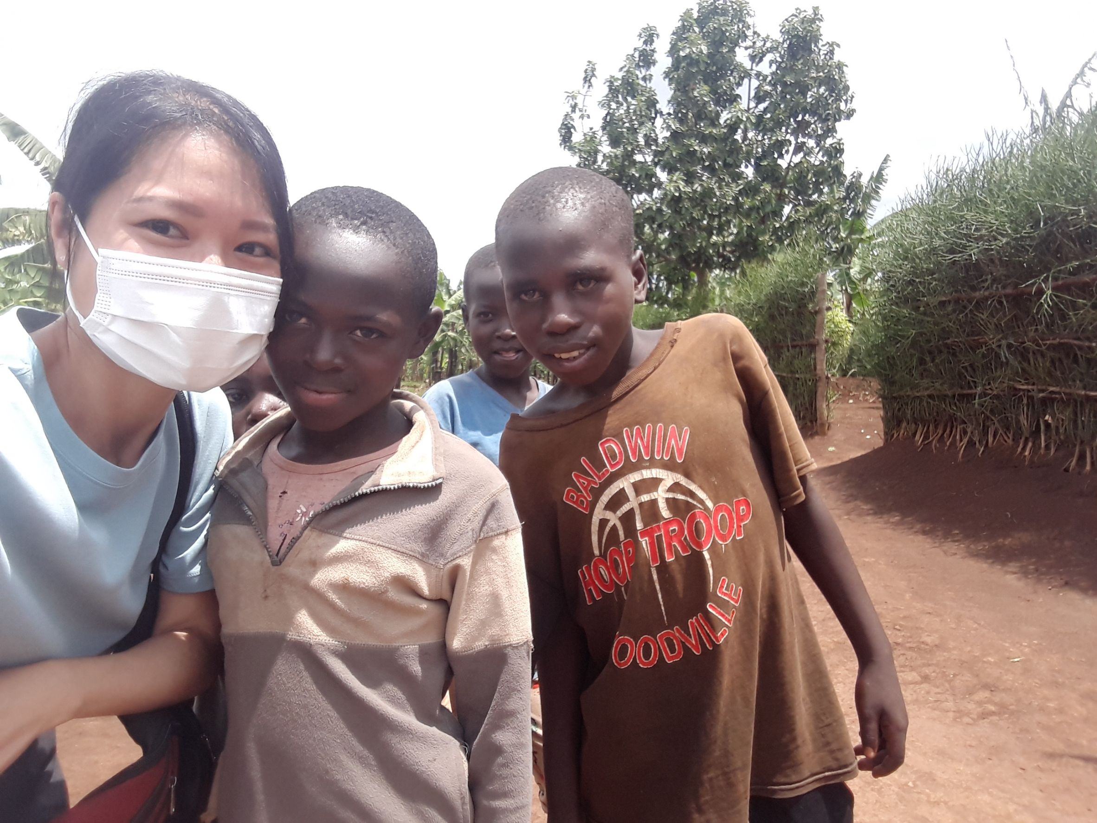
Japan Overseas Cooperation Volunteer
Saki san from Rwanda
Notes:
Hello! I’m Saki Ito.

Slide 2
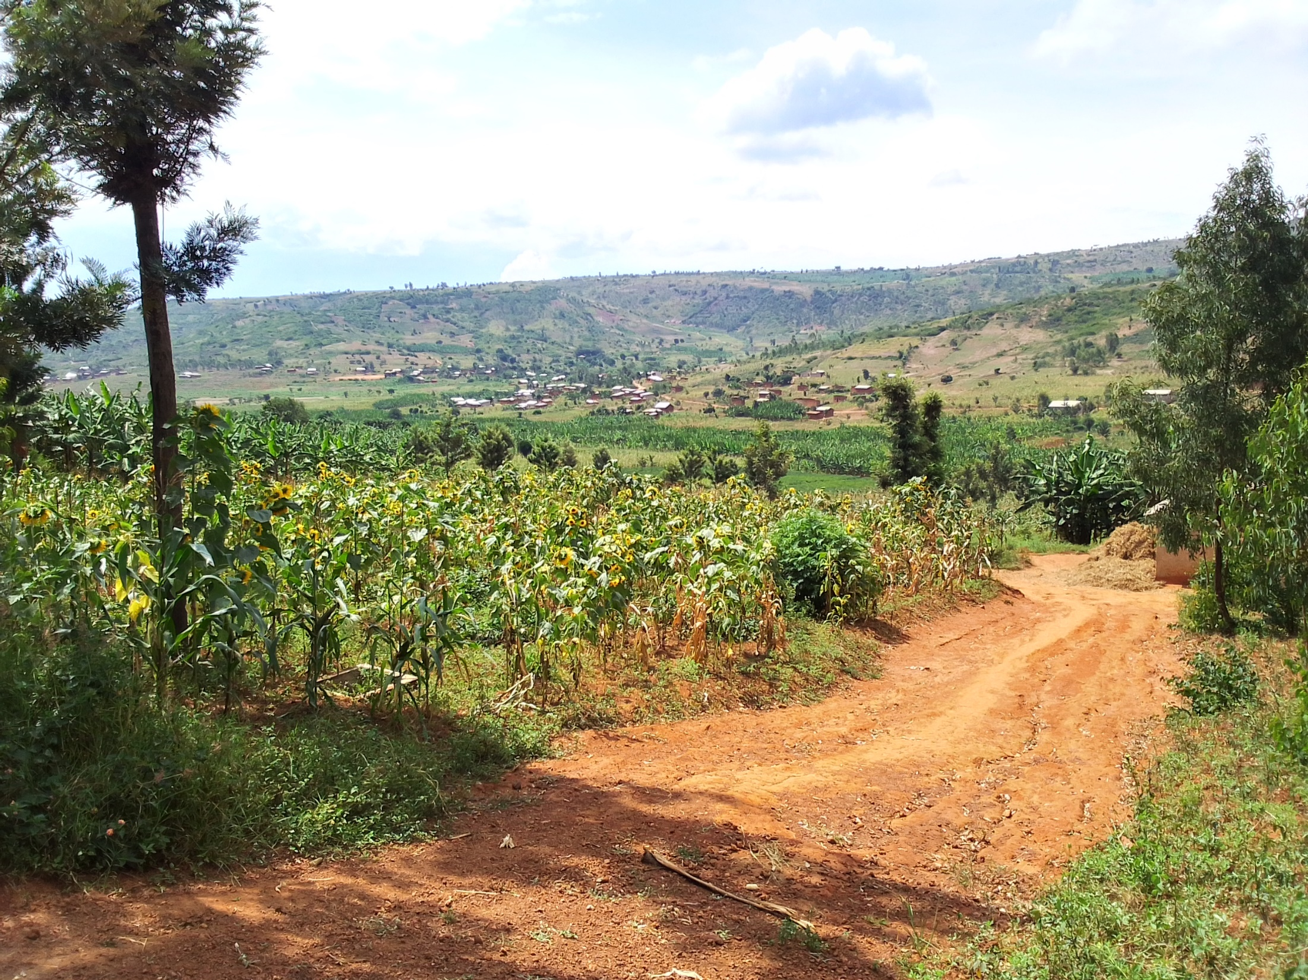
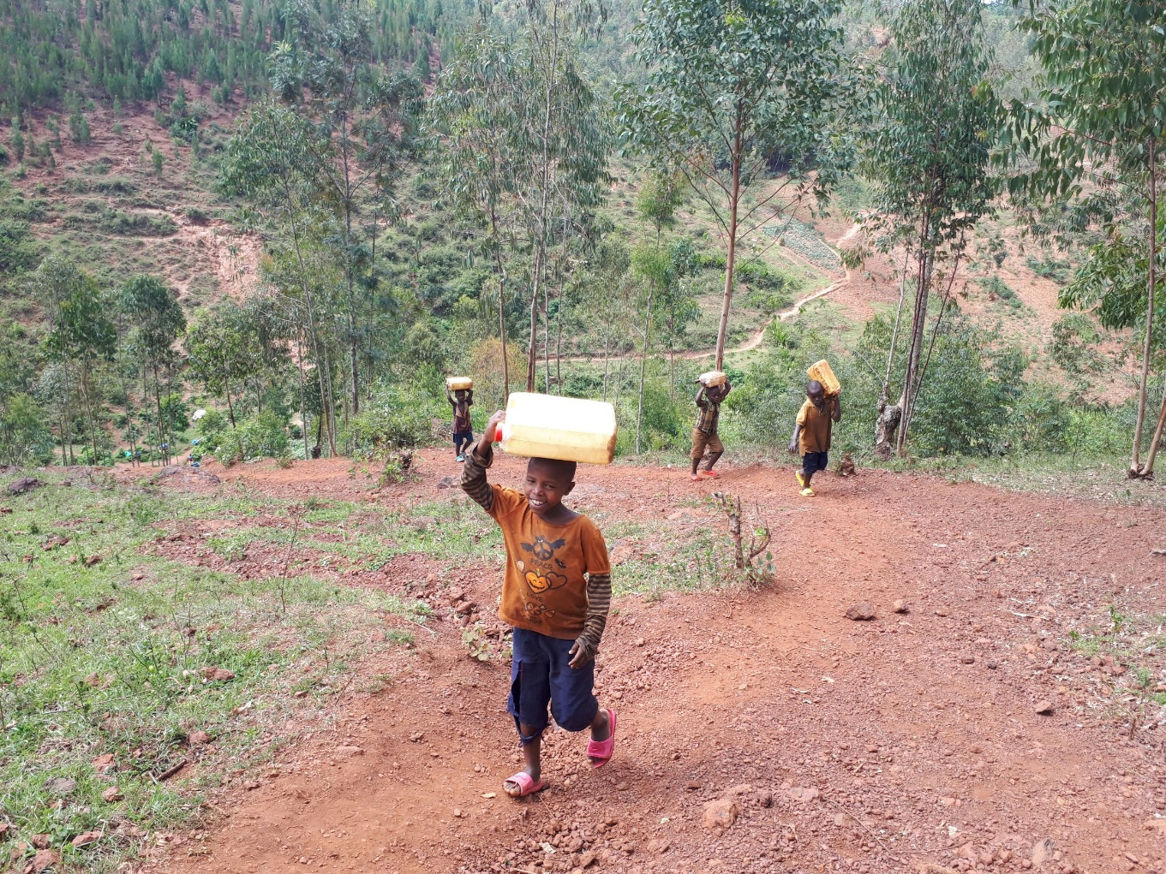
My Place
Hills and Red soil road
Getting water
Notes:
I live in Kayonza district, eastern region of Rwanda. This are is short of water. Women and children get water from spring water or water from wells, which are far from their houses.
Kids get water far from their house by walking a mountain path.
They have to make many round trips with 10L tank.
Rwanda is called “Thousand of hills”. Sunflower and banana field spread out as far as the eye can see. that’s wonderful.
The climate there is comfortable throughout the year, so I often take a walk and enjoy communication with local people on weekend.
(Learning local language struggles to me though…)

Slide 3
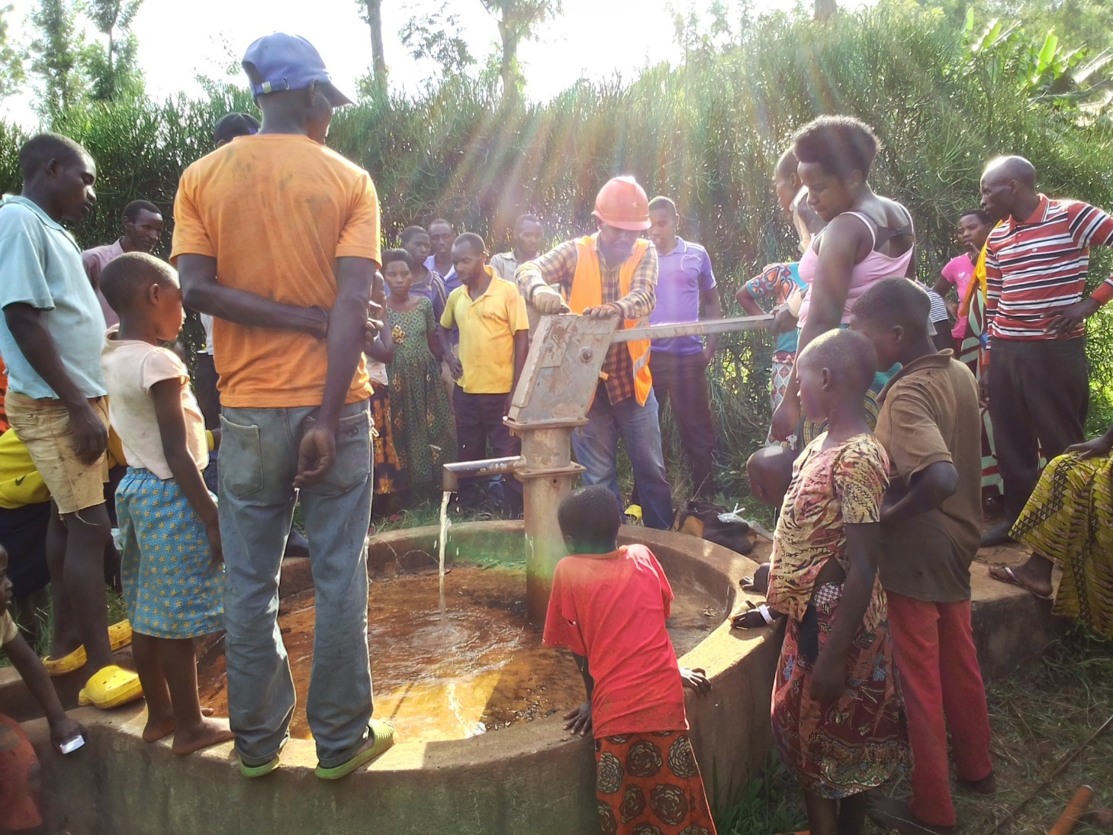
My Activity
Repairing Hand Pump
Notes:
There are many hand pump style wells in my place. They are built by foreign aids.
However, when they are broken, they don’t know how to fix them, and they are are often abandoned.
People have to go far away to get water, or they drink dirty water getting from a river flowing nearby.
To improve this situation, I support to fix the hand pumps and check water quality to focus their attention to water safety.
When I go to the villages, some villagers say “Give me money.” But the support like giving things or money will not last long and same problems can happen.
Therefore, I advice them to think how they can gather enough money to fix hand pumps.
It’s difficult and sometimes they almost give up. I encourage them and I’m very happy to see the happy faces of people when the water run through again from the hand pump.

Slide 4
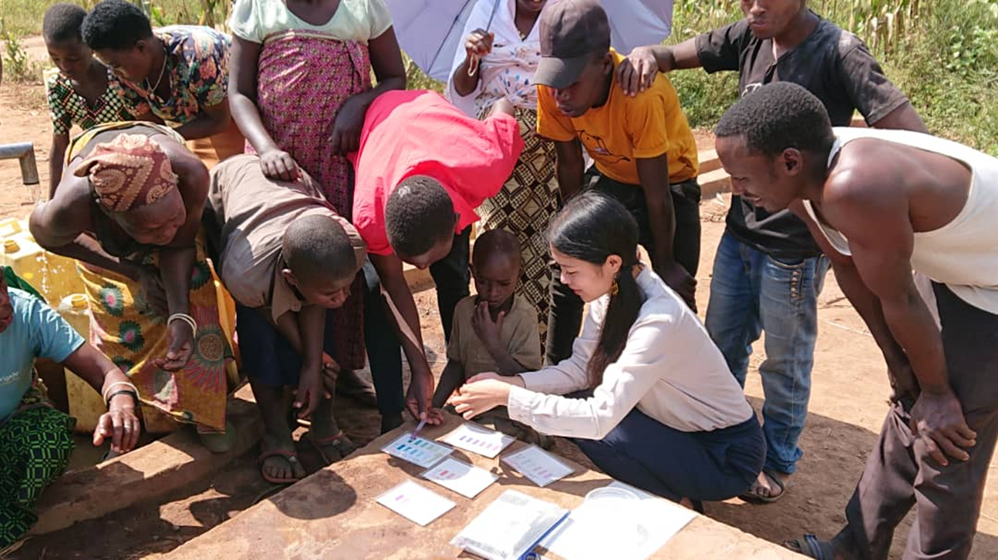
Checking of Water Quality
Notes:
I check various polluted substances, and tell villagers to focus their attention to water safety.

Slide 5
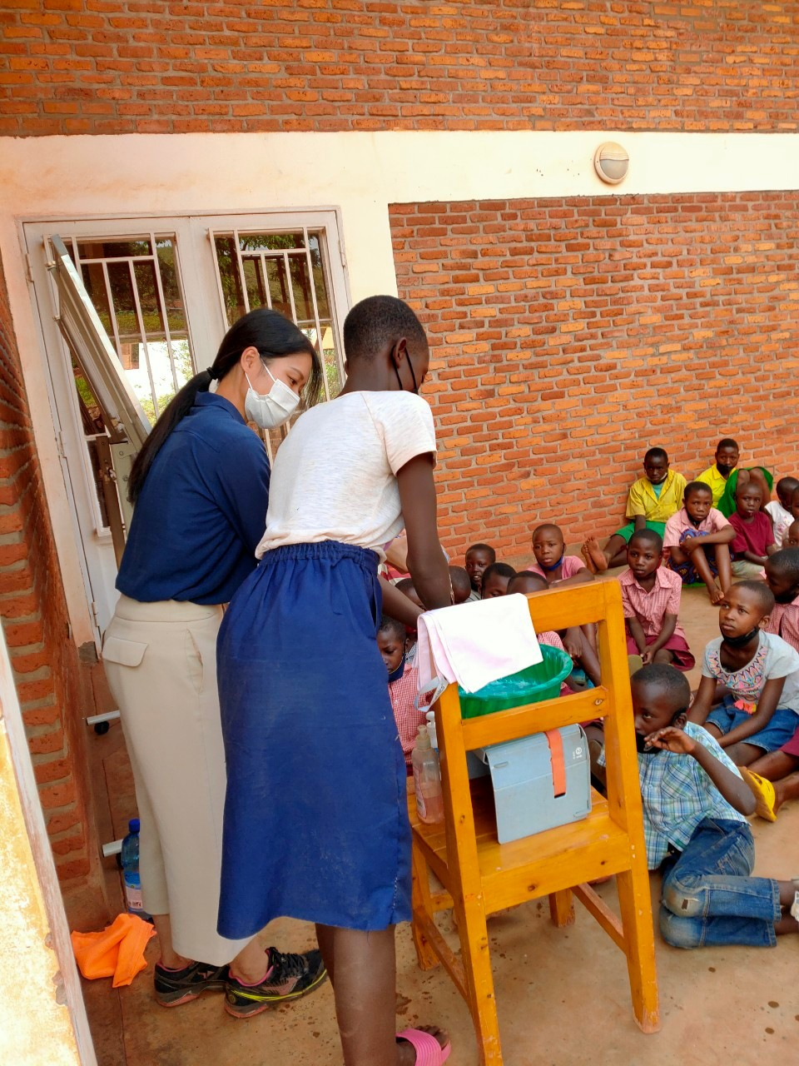
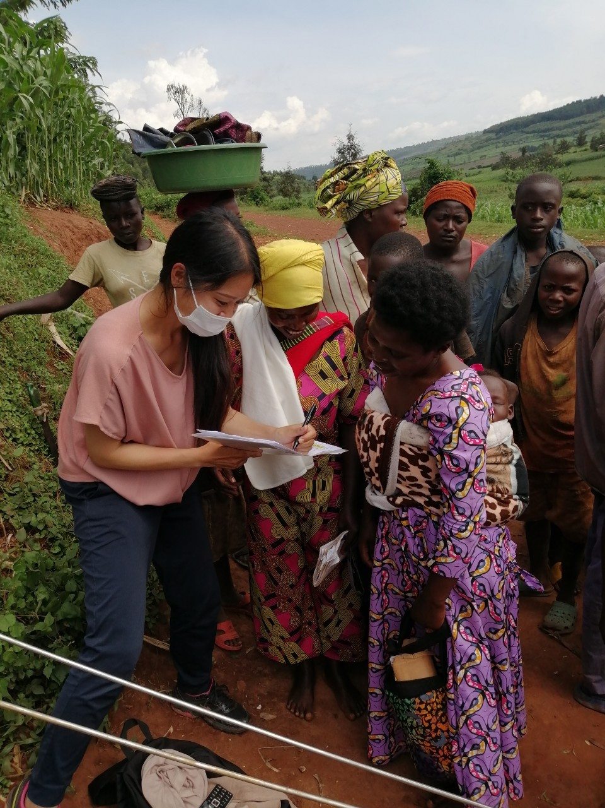
Hand Washing Workshop
Training in Water Committee
Notes:
Hand washing workshop…Firstly kids wash their hands by themselves. After that, We check the part that they can’t wash and teach a right way wash their hands.
Training in water committee…To manage the pumps by themselves, we made a committee. This photo was taken when I explained their roles.

